Slide 1
BTEC LEVEL 2 TECH AWARD
Promotion and Finance for Enterprise

Slide 2
INTRODUCTION
You will explore the different promotional methods used by enterprises and the factors that influence how enterprises identify and target their market.
You will explore financial documents and how to use them to monitor and improve the performance of an enterprise in order to make decisions and recommend strategies for the success of an enterprise.

Slide 3
THE EXAM
This external component builds on knowledge, understanding and skills acquired and developed in Components 1 and 2. Learners will be provided with a case study of a small to medium enterprise (SME), and a series of activities to complete.
Learners will complete a task worth 60 marks under supervised conditions. The supervised assessment period is a maximum of two hours and must be arranged in the period timetabled by Pearson.

Slide 4
ASSESSMENT OBJECTIVES
AO1 Demonstrate knowledge and understanding of elements of promotion and financial records
AO2 Interpret and use promotional and financial information in relation to a given enterprise
AO3 Make connections between different factors influencing a given enterprise
AO4 Be able to advise and provide recommendations to a given enterprise on ways to improve its
performance

Slide 5
A1- ELEMENTS OF THE PROMOTIONAL MIX AND THEIR PURPOSES
In this topic you will explore the different methods of promotion used by enterprises, their suitability for different sizes of enterprise, including the factors they consider when choosing the most appropriate.

Slide 6
STARTER
Think of as many different advertising methods as you can with your shoulder partner.
Advertising Methods

Slide 7
ADVERTISING METHODS
The message: what the communication needs to say
The medium: how to get the message across
Advertising methods: moving image, print, ambient, digital, audio
Sales promotion: providing incentives to customers, buy one get one free, or discounts
Methods: coupons, competitions, money off, loyalty cards, buy one get one free, discounts
Personal selling: face to face, by telephone, via email, through video or web conferencing
Public relations activities: promoting a produce/service, brand or enterprise by placing information about it in the media without paying for the time or media space directly
Methods: exhibitions, sponsorship, press releases
Direct marketing to establish an individual relationship between the enterprise and the customer
Methods: direct mail (junk mail), mail order catalogues, magazines, telemarketing

Slide 8
ADVERTISING ACTIVITY
Go to Google Images (http://www.google.com/imghp) and find three advertisements that appeal to you.
Try to determine the following features of each ad:
Who is the target audience?
Who is represented in the advertisement?
Who is the advert intended for? (age, gender, race/ethnicity, socio-economic status, etc.)
Which of the following persuasive techniques have been used?
Visual metaphors (image that represents an idea)
Catchy phrases/slogans
Mood/tone/emotion
Celebrity Endorsements
Music/sound
NEXT: Create an ad for something in your own life. Think about all of the persuasive techniques above when you create. How did deconstructing these three advertisements help you better understand advertisers’ methods?

Slide 9









ACTIVITY
CHOOSE ANY 2 OF THE FOLLOWING BUSINESSES AND WRITE A REPORT ON AT LEAST 2-3 DIFFERENT ADVERTISING METHODS THEY USE AND WHY…
45 mins
Extension Task: What methods are they currently not using that they could benefit from? E.g. could the business incorporate more PR or Direct Marketing?

Slide 10
A2-MARKET SEGMENTATION
Segmentation is a common strategy used in marketing to break down a large target audience into smaller, more homogenous groups of customers. The point is to make marketing efforts more efficient by investing in communication that connects with customers most likely to buy your product, while minimizing wasted spending on those who won't. Several common techniques are used to segment markets.
THINK: Can you think of the different ways in which businesses can split the market?
https://www.youtube.com/watch?v=DUuirqtSqpg

Slide 11
SEGMENTATION
Types of market: Business to Business (B2B), Business to Consumer (B2C)
Segmenting the market to identify which customers its promotions will target through:
demographics: age, race, religion, gender, family size, ethnicity, income, education level, socio-economic group
geographic: location
psychographic: social class, attitudes, lifestyle and personality characteristics
behavioural: spending, consumption, usage, loyalty status and desired benefits

Slide 12
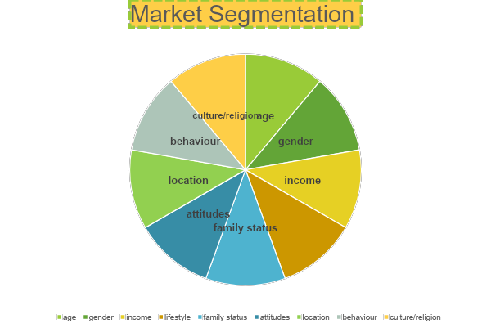
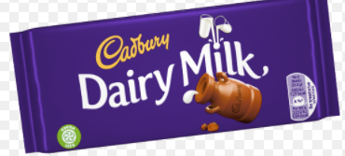
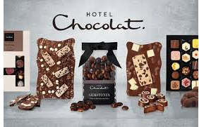
What is the difference between the targeted market segments for both of these products?

Slide 13
B2B AND B2C
B2C and B2B are two forms of commercial transactions. B2C, which stands for business-to-consumer, is a process for selling products directly to consumers. B2B, which stands for business-to-business, is a process for selling products or services to other businesses.
This typically occurs when a business is sourcing materials for their production process (e.g. a food manufacturer purchasing salt and other raw materials)

Slide 14
ACTIVITY
Using the Internet for help, write a paragraph summarising all of the different types of market segmentation and what each of the words mean.
After this, click one of the business links below and write a report on how the business segmented the market for their brand.
Canon: http://www.marketing-interactive.com/case-study-canon-carve-new-market-segment/
Nivea: http://www.marketing-interactive.com/case-study-canon-carve-new-market-segment/
Porsche: http://theporschegarage.blogspot.co.uk/2012/04/ch-8-segmenting-and-targeting-markets.html
Coca Cola: http://elbaz-coca-cola.blogspot.co.uk/2011/11/ch-8-segmenting-and-targeting-markets.html
In your report, think of the following questions:
What segment of the market are the business trying to target? Why have they chosen these segments?
Does the business use B2B or B2C or both? Explain using examples.

Slide 15
MARKET SEGMENTATION
Complete the Market Segmentation Worksheet by thinking of a new product or service you could offer. You then need to decide which segments you will be targeting and justify your choices.

Slide 16
A3- FACTORS INFLUENCING THE CHOICE OF PROMOTIONAL METHODS
• Size of enterprise
• Budgetary constraints
• Appropriateness for product/service
• Target market
How might the following affect the promotional methods you choose?

Slide 17


ACTIVITY
For the following businesses write down which of the factors they would be affected by and WHY. Each factor must be explained in depth and how it affects the business.
For each of the following explain:
The size of the business (micro, small, large etc)
The type of advertising and promotional budget they would have. Would they have any budgetary constraints? If so, why? How might this affect them in a negative/positive way?
What would be the most appropriate methods of advertising/promotion for each business
How would this meet the needs of their target market?

Slide 18

PLENARY
Summarise what you have learnt today in exactly 30 words.
Share this with your shoulder partner.

